Slide 2
Learning Objectives:
Students will be able to understand the concept of square , square root square number and also study the facts about perfect squares ,triangular number. Able to find the square root by various methods and study its application.
Learning outcome:
Define square numbers.
Identify the perfect square numbers.
Develop some patterns of square numbers.
Verify the given number is a perfect square number or not.
Recall the facts about perfect squares.
Explain the facts about perfect squares .
Calculate the square roots of perfect squares by using prime factorisation and long division method.
Evaluate the square root by estimation method.
To solve the word problems related to square and square roots.

Slide 3
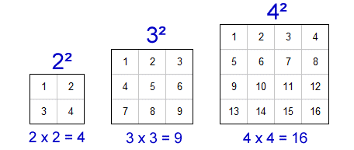
INTRODUCTION
One day two friends went to a park to play .There they saw a neat and clean swimming pool which is in a square shape of side 10m.They decided to swim.
Tell me what will be the area of that swimming pool
Yes, the answer is 100m²,
How did you get 100 ?
when 10 is multiplied by itself
Suppose your friend asks you to find a number which when multiplied by itself gives 25. You can easily answer it. 5 multiply 5 gives 25. It is similar to finding the length of the side of a square when its area is known.
.
What is 5 known as? 5 is the square root of the square number 25. You can say finding square roots are the inverse operations of squaring. In this section, we will study about square root in more details.
Note : So, the numbers 4,9,16, 25,100,169 are known as square numbers or perfect squares

Slide 4
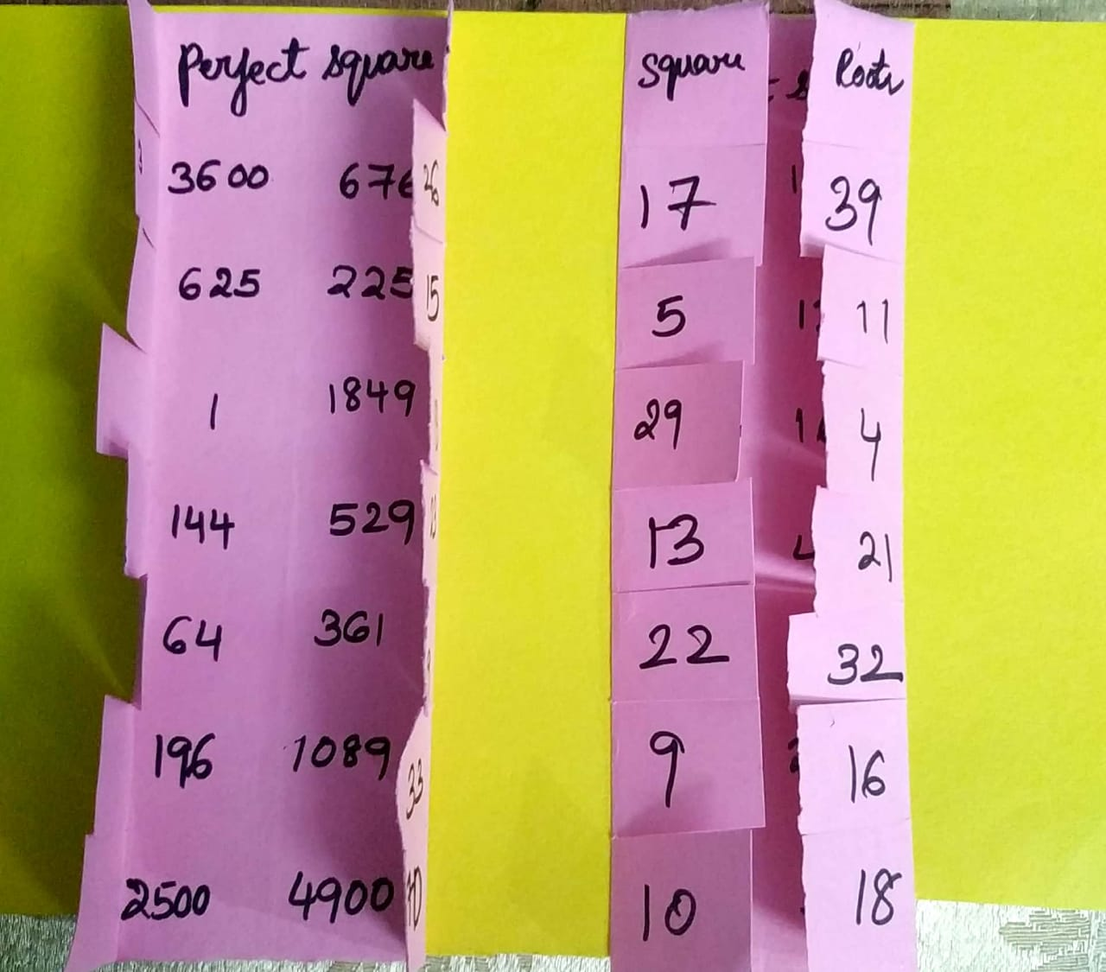
Activity
How to remember square root and perfect square of a given number with the help of foldable activity.
Please double click on below video clip icon:

Slide 7
OBSERVE SOME INTERESTING PATTERN BETWEEN TWO
CONSECUTIVE SQUARE NUMBERS
Consecutive square numbers | Non-Square numbers | Number of non-square numbers | Observation
1² and 2² | 2,3 | 2 | 2 x 1=2
2² and 3² | 5,6,7,8 | 4 | 2 x 2=4
3²and 4² | 10,11,12,13,14,15 | 6 | 2 x 3=6
4² and 5² | 17,18,……24 | 8 | 2 x4 =8
5²and 6² | 26,27,…..35 | 10 | 2 x5=10

Slide 8
It’s time to think
Can you say how many non-square numbers are there between 6²
and 7²
Can you say how many non-square numbers are there between
101² and 102²
yes, you are correct
2x 6=12
2x 101=202
Now let us generalise the observation:
We find that if we take any natural number n and (n+1) the number of non-square numbers between n² and (n+1)² is 2n

Slide 9
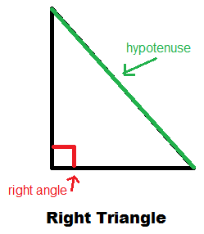
Observe the triangle and answer the following questions
What type of a triangle it is?
Can you find any relation between its sides?
Does (3,4,5) forms a right angle triangle?
If one side is 8cm then, what will be the other two sides of a right angle triangle?
If one side is 9cm then ,find the other two sides of a right angle triangle.

Slide 10
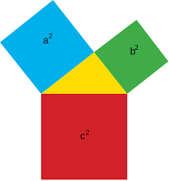
To answer those question you should understand the below definition
Pythagorean Theorem: In a right angled triangle the square of the long
side is equal to the sum of the squares of the other two sides. It is stated in this formula: a² + b² = c² the long side is called the hypotenuse.
Note:
The Pythagorean triplet makes a right angle triangle
Example: (3,4,5),(5,12,13),(9,40,41)

Slide 11
PYTHAGOREAN TRIPLET
Let us have more idea on this by solving the problem
Example: if one of the triplet is 8 then find other number of the triplets
2m=8=>m=4
m²-1=16-1=15
m²+1=16+1=17
(8,15,17)
Note : (8,15,17) forms a right angle triangle
Check : c²=17²=289, a²= 8²= 64, b²= 15²= 225
C²= a²+b² =>289=64+225
=>289=289
NOTE: If the smallest even number is 2m then the Pythagorean triplet is
(2m , m² -1 , m² +1)

Slide 12
How to form a Pythagorean triplet
If the number is odd: Square the number N and then divide it by 2. Take the integer that is immediately before and after that number i.e., (N²/2 -0.5) and (N²/2 +0.5). Pythagorean triplet= N, (N²/2 -0.5), (N²/2 +0.5)
Example: take number N=3. On squaring the number, we get 9. Now take the half of it. 9/2= 4.5 the integer immediately before 4.5= 4;
the integer immediately after 4.5= 5 therefore, the triplet is (3, 4, 5).

Slide 13
It’s a time to think and answer
Which number multiplied by itself to give the result as 169?
Yes, the answer is 13 because 13 x 13 gives 169

Slide 18
Apply the concepts which you had learned from the previous slides and try to answer these questions
Find the square root of 256 by repeated subtraction method.
Find the square root of 3136 by prime factorization method
Find the smallest number by which 1100 must be multiplied such that the product becomes a perfect square. Also , find the square root of the perfect square obtained.
Find the smallest number by which 3645 must be divided such that the result becomes a perfect square. Also, find the square root of the perfect square obtained.
Find the square root of 4401604 and 1734489.
Can you solve this question:
When numbers are very large the method of finding their square root by prime factorization method becomes lengthy. So, we use long division method

Slide 19
Cont. next slide

Slide 22
Square root of a rational number
Rule – 1: For perfect squares a & b √(axb)=√a x √b
Rule – 2 : If a and b are perfect squares(b≠0),then √(a/b)=√a /√b
Solve these questions by applying above two rules.
Q-1 : find the value of $\sqrt{49X25}$.
Q-2 : find the value of $\frac{\sqrt{243}}{\sqrt{867}}$

Slide 23
Square roots of numbers in decimal form (which are perfect square)
Example -1

Slide 24
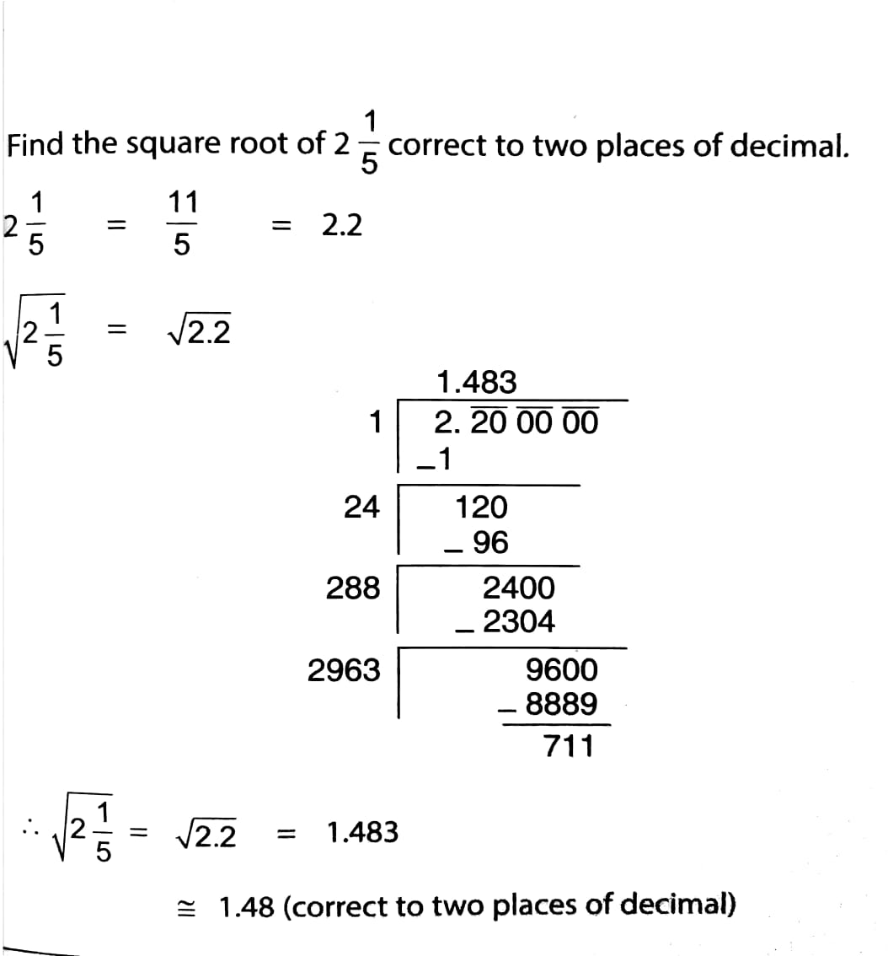
Approximate value of the square roots of numbers (which are not perfect squares)
Look at this example:

Slide 25
Finding square roots by estimation (non perfect square numbers)
Example: Find the square root of 410 by estimation
Solution: the perfect square near to 410 are 400 and 411
i.e., 400<410<441
20²<410<21²
We guess the answer is between 20 and 21
Let us try with 20.3 as 20<20.3<21
But, (20.3)²=412.09>410
I.E., 20²<410<(20.3)²
Let us try 20.2 we get (20.2)² <410<(20.3)²
We take square root of 410 as 20.2 approximately

Slide 26
Double click on this video to know how to estimate a non-perfect square using square grid

Slide 27
MIND MAPPING
Squares and Square Roots
Square numbers or perfect squares Eg:4,9,25,36
Square roots
2n non square numbers between two consecutive square numbers
Inverse operation of square eg:√4=2 ,√36=6
Long division method
Subtraction method
Prime factorisation method
Pair the given number and divide by the square of a number proceed the process by repeatedly adding the last digit to the divisor
Successive odd number are to be subtracted till the result is Zero
Prime factors of equal numbers are paired and one factor from each paired is multiplied.
Square root of perfect and non perfect square numbers can be determined.

Slide 28
The square of a number is that number raised to the power 2.
A square number is never negative
A number ending in 2,3,7 or 8 is never a perfect square.
Square of even numbers are always even.
Square od odd numbers are always odd.
A perfect square number leaves a remainder 0 or 1 on division by 3.
There are no,natural numbers p and q such that p²=2q²
If a and b are perfect squares(b≠0),then√(axb)=√a x √b
And √(a/b)=√a /√b
If p and q are not perfect squares ,then to find √(a/b),we express a/b as a decimal and then apply division method to find the square root.

